Slide 1
DSP w3

Slide 2
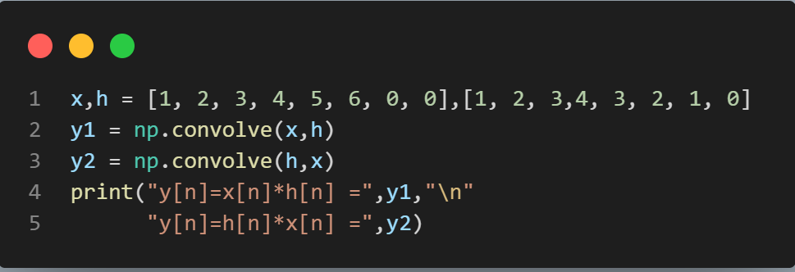
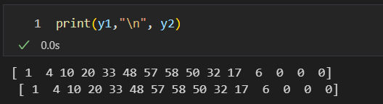
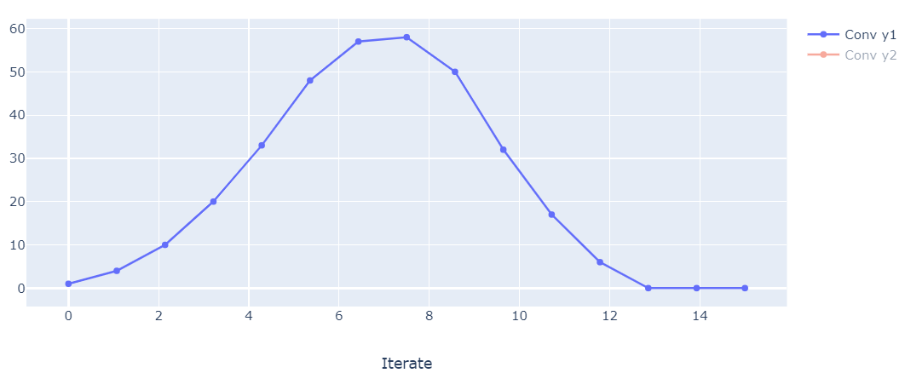
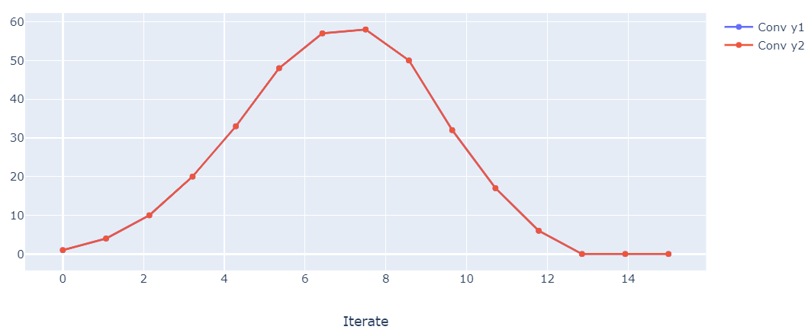
A)
x[n]={1, 2, 3, 4, 5, 6, 0, 0} & h[n]= {1, 2, 3, 4, 3, 2, 1, 0}, Check y[n]=x[n]*h[n] & y[n]=h[n]*x[n] .

Slide 3
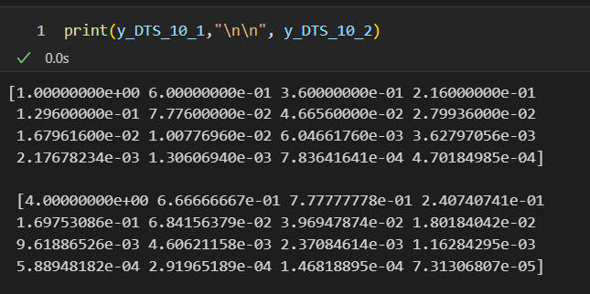
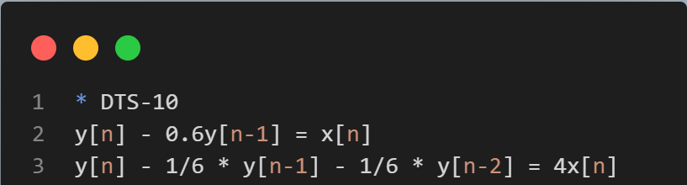
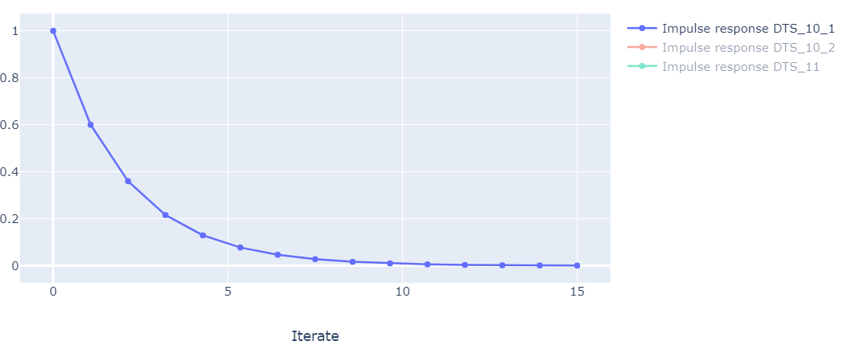
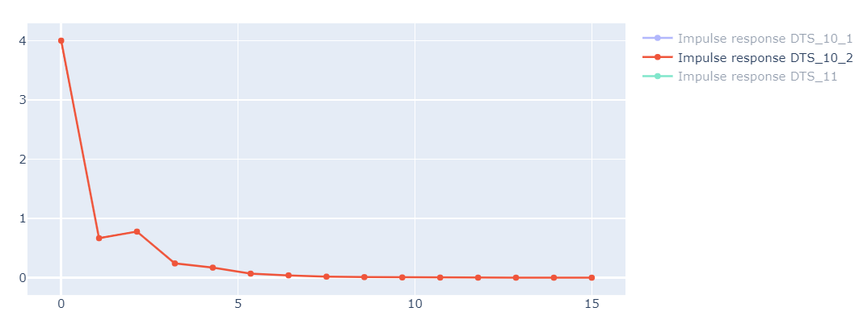
B)
Impulse response of DTS-10 & DTS-11. (at least 16 coeff.)

Slide 4
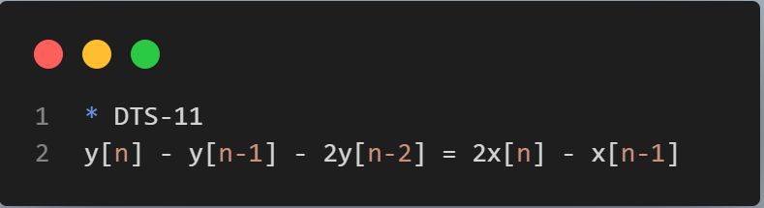
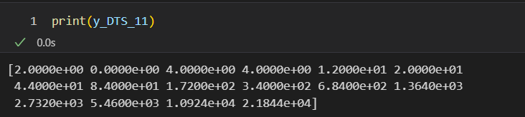
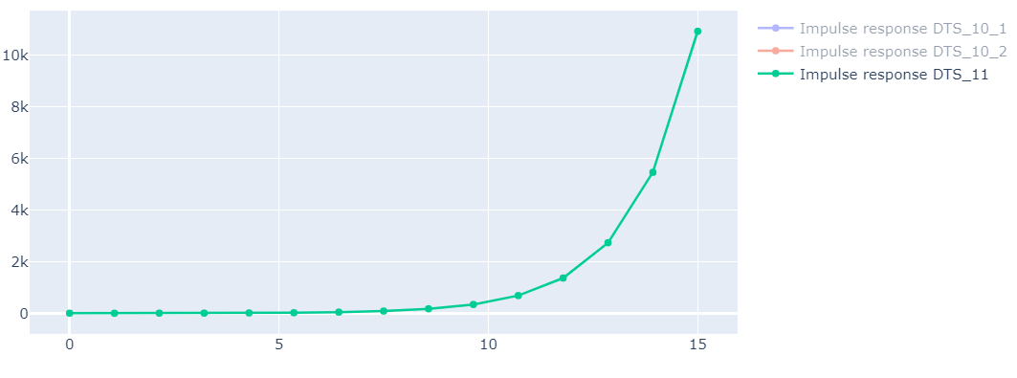
B)
Impulse response of DTS-10 & DTS-11. (at least 16 coeff.)

Slide 5
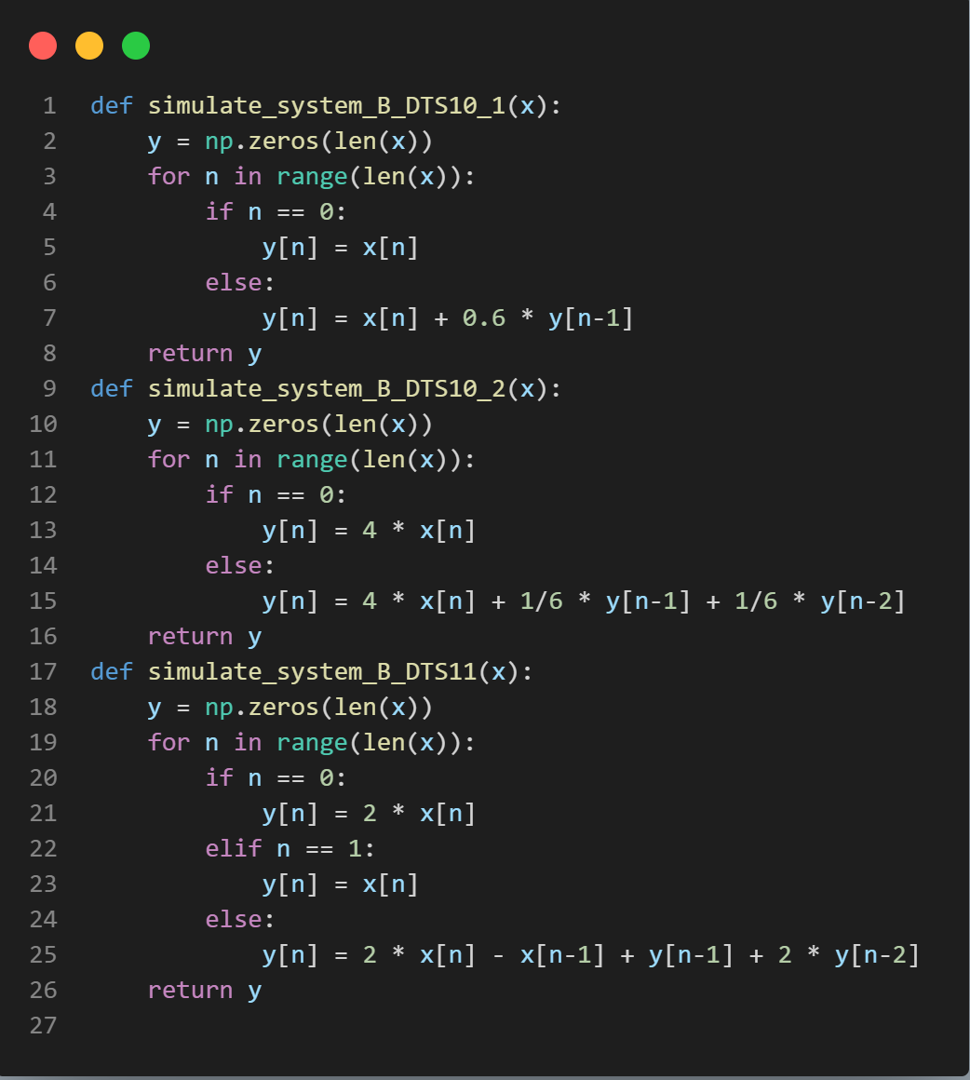
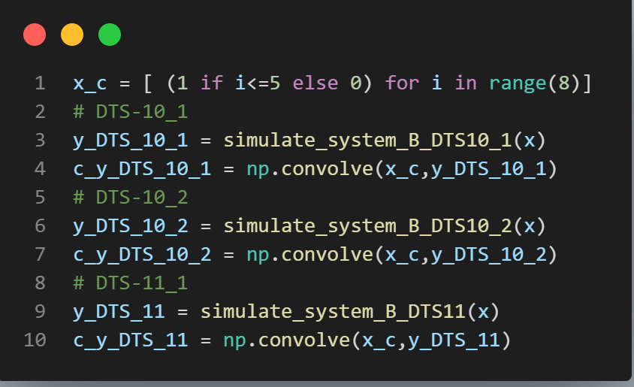
C.)
h[n]=DTS-10 & DTS-11, x[n]={1, 1, 1, 1, 1, 1, 0 ,0}, check y[n].

Slide 6
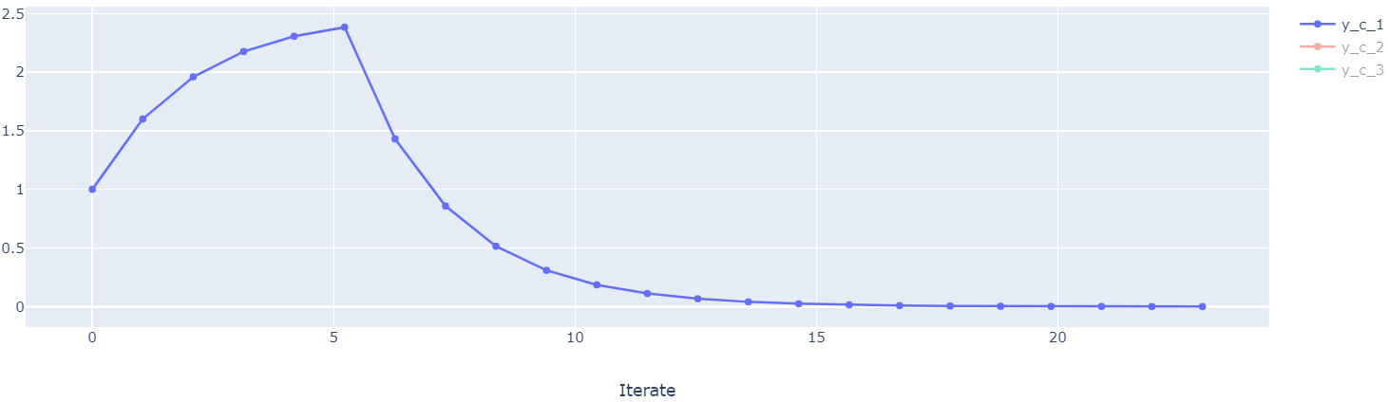
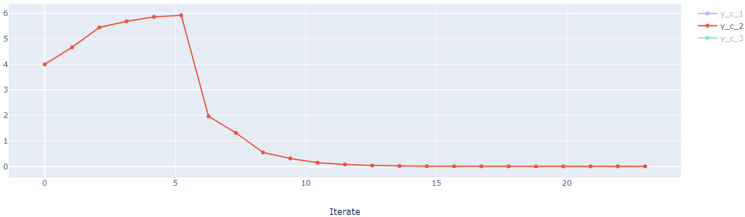
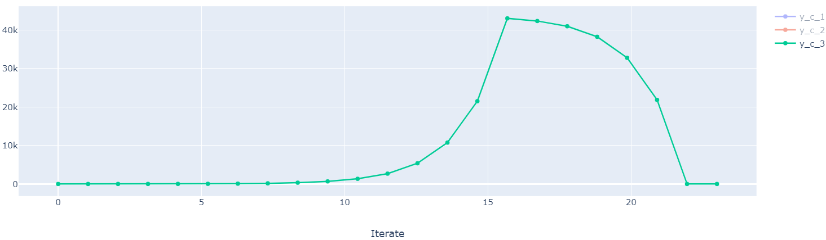

Slide 7
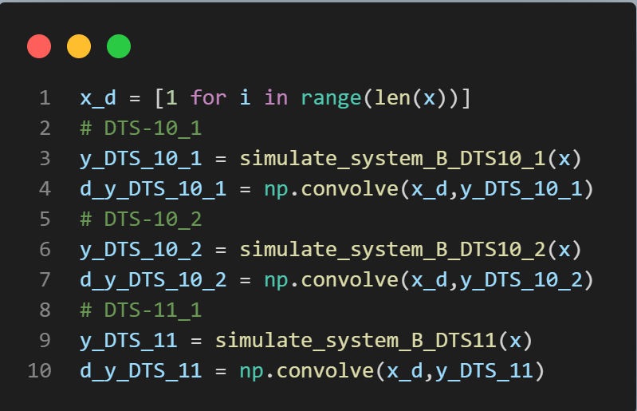
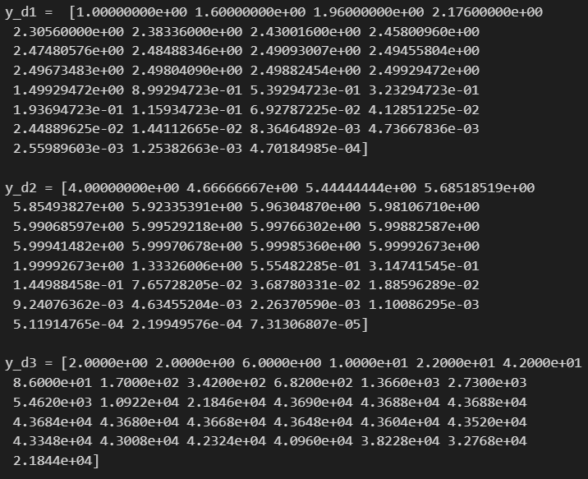
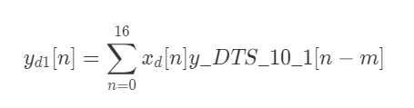
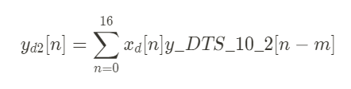
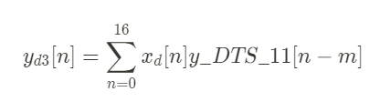
D.)
h[n]=DTS-10 & DTS-11, check the DTS solution for x[n]=u[n].

Slide 8
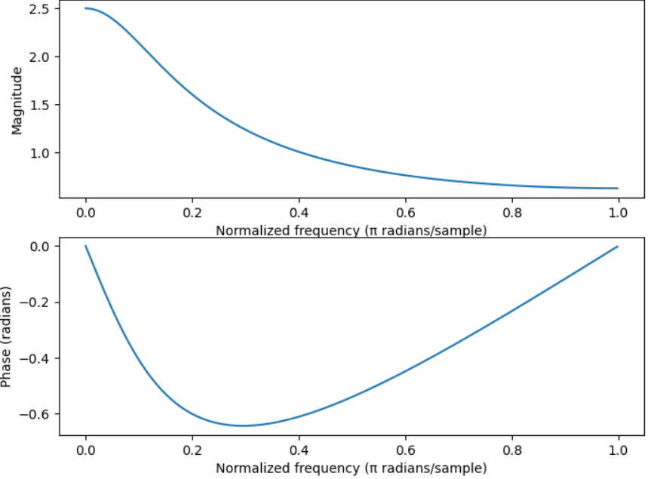
E.)
h[n]=DTS-10 & DTS-11, check the frequency response of DTS.
y[n] - 0.6y[n-1] = x[n]
H(z) = Y(z)/X(z) = 1 / (1 - 0.6z^-1)

Slide 9
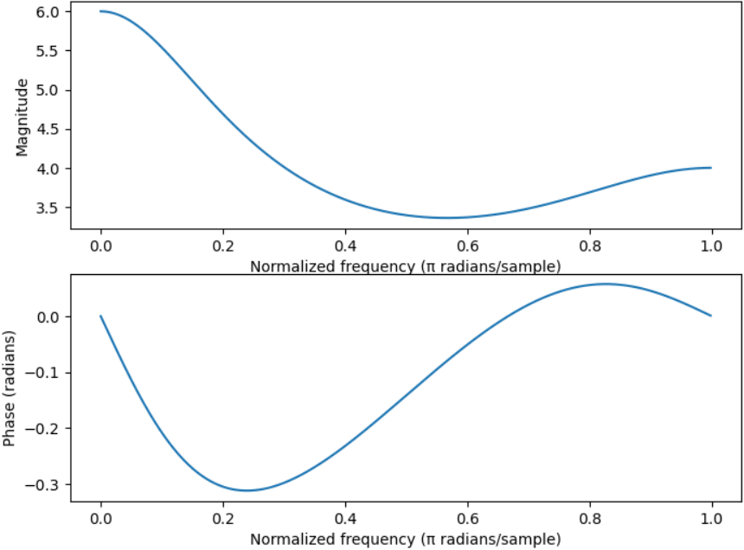
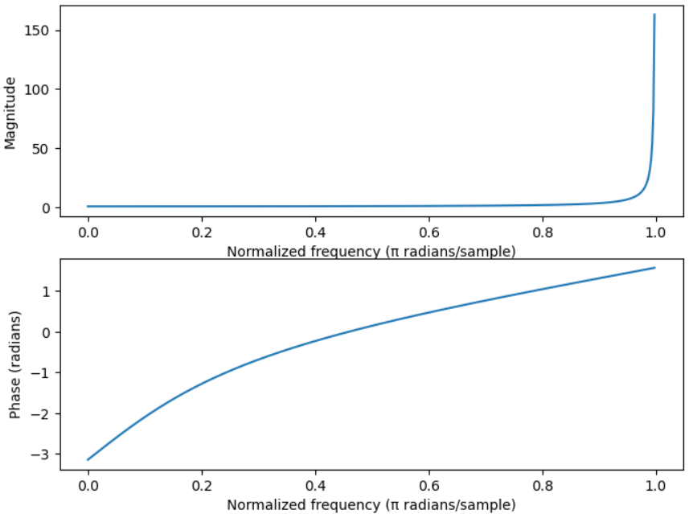
y[n] - 1/6 * y[n-1] - 1/6 * y[n-2] = 4x[n]
H(z) = Y(z) / X(z) = 4 / (1 - 1/6 z^-1 - 1/6 z^-2)
y[n] - y[n-1] - 2y[n-2] = 2x[n] - x[n-1]
H(z) = Y(z) / X(z)= (2z - 1) / (z^2 - z - 2)

